Slide 1
Leadership Development
“How to Survive – and Grow – During Change”
Lambda Epsilon Omega
Leadership Development Committee
May 16, 2020
Notes:
Welcome to this month’s Leadership Development module focusing on professional growth during this period on unprecedented challenge and change.
I am Soror Glynis Lee, and will spend the next few moments presenting a few pointers to assist you in attaining your career goals.

Slide 2
No one is in the same position they were 2 months ago. Take advantage of this detour.
Notes:
We all know that COVID-19, and this global pandemic, have resulted in a social, economic, and corporate conditions we could ever imagine. During this time, it is imperative that we focus on the opportunities these conditions may present for you in your professional growth.

Slide 3
What Drives Success?
Leaders that are most successful are leaders that are more: Adaptive, Flexible, and Agile
Successful leaders are able to see the moment; they also are able to seize the moment.
Notes:
In any climate, successful leaders demonstrate adaptability, flexibility, and agility. This climate will expose true leaders who are able to seize this time to make appropriate adjustments to align with the times.

Slide 4
Set the Foundation: Be YOU-SMART
Practice “Mindful Daily Practices” that build confidence, connection and calm
Employ Breaks, Standing, Exercising
Set boundaries in both time and space
Proactively manage your calendar
Manage your work from home “guilt”
Notes:
If you are not at 100%, you cannot give 100%. It is not selfish to take care of yourself. I cannot stress how important it is to implement a schedule that aids in improving your overall disposition and health.
Include breaks, standing, and exercising through the day – eat right!
Many of us are not only adjusting to working remotely, we are also full time parents and teachers in addition to our professional responsibilities. Identify your “work space” separate from the “play space” – don’t merge these areas. Have a standard start and stop time, and continue with a set schedule.
Help others respect your space by proactively managing your calendar.
Don’t give in to the guilt of working from home. Continue to give your all – don’t fall into the trap of working longer days or weekends as proof you are not taking advantage of working remotely. Clarify the expectations of your management and clients and align your contributions accordingly.

Slide 5
Set the Foundation: Be YOU-SMART
Find the “Pause Cafe”
P | Pause and take a deep breath
A | Ask yourself – “What is going on with me”
U | Untangle what is an “Assumption” and what is “Truth”
S | Step back, and allow the constricted view to open
E | Extend Compassion to yourself
Notes:
Mary Lee Gannon, a professional coach, has presented the idea of a “Pause Café: As a professional, and especially as a leader, you need to regulate your emotions in the moment to remain open to opportunity and develop engagement. Take these mindful steps so that when you feel stressed, threatened, or worried – this method will quickly release the tension and shift perspective – before your behavior repels your team and the people you care about.
Pause and take a deep breath.
Ask yourself what is going on with me? Be vulnerable – it means you are human.
Untangle what is an assumption and what is truth. Do you have all the facts?
Step back and allow the constricted view to open. Sometimes a physical step back is warranted. Imagine a peaceful setting and think – what else could be going on?
Extend compassion to yourself. Hug yourself; then extend compassion to others.

Slide 6
Showcase Your Leadership
Strike a power pose
Embrace discussion and reflection – “Deep Listen”
Lead with compassion
Manage expectations
Over communicate
Be known as a mindful and servant leader
Notes:
Remember you have what it takes!
Strike a power pose. Even in a remote environment, your body language, voice, and tone are key. Sit upright with your shoulders back in confidence. Take a few moments prior to a meeting where you are facilitating to prepare yourself. Write down talking points so you do not stammer over your words and messages.
Learn to listen without formulating a response in your head. Wait until you solicit feedback and affirm what has been said before offering your editorial – this leads to building trust as the other person feels heard.
Have compassion. Care about people as more than a productivity metric – connect what they personally value to the values of the organization. Connect with team members frequently not on work tasks – check on their emotional well being
Manage expectations – and over communicate!! Be clear about your expectations as we are no longer co-located with our team members. Ensure your team knows your vision and the role you expect them to play. Open meetings with a perspective shift; leave meetings with an accountable action plan.
Be true to your word. Be sound in your behavior. Be true to yourself and servant leader to all, even those who are unkind or jealous of you.

Slide 7
Create a Culture of Win-Win Solutions
Be a thought leader – Think BIG!
Anticipate problems and opportunities. Reframe problems to be solution focused.
Be the “Rent-an-Adult”
Notes:
Do not be situation focused. Know the mission, vision, and values of the organization so that when there is discord you can go back to them to ground yourself and the team. Confusion is the enemy – so listen deeply and separate people from the problem. Build alignment where everyone feels heard. And create solutions.
Don’t present a problem without a solution. Complaining reveals something about yourself it reveals your capacity. Raise your capacity by moving beyond the complaint to formulating a solution.
Especially in these turbulent times, be the one who is able to step back and say “Maybe we can think about this for a couple days and develop some alternatives.” Be the person who listens deeply and affirms rather than argues. Don’t insert yourself into the emotion of the situation.

Slide 8
Position Yourself for Success
Know your “WHY” – Your Value Proposition
Write down your career vision and back into your goals
Pursue continuous development
Ask for feedback
Make lateral moves to gain experience
Create your personal Board of Advisors
Notes:
Influencers know not only what they do, but why. Ask yourself simple value proposition questions: why should teams, colleagues, employees, clients, prospects work with me? Why should they mentor me or do business with me? What is it that only I can help someone with because of my unique talents, perspective, and experience? What makes me indispensable? Be able to describe your value proposition in two sentences.
Know your career vision. Write down your vision. Solidify the steps to get there. Sketch what it looks like. Notice the career track of people you admire have taken to reach their positions. Reflect on your vision and ensure your goals align.
Use what would have been “commute” time to pursue professional development. Coursera, Lynda.com, etc. are free or low cost resources to assist you with soft skills and technical skills.
Show humility. Invite feedback on yourself; thank them and announce what you are working on. Be specific in your request – If you were me, what is something you would do more of? What is something I could improve? What is something I should stop doing?
Building experience in diverse specialties can make your leadership more broadly sought after. A person demonstrating the agility to pivot to different areas tend to be more successful than those that have a single focus. Move laterally only to gain valuable experience.
Finally – Create your personal Board of Advisors

Slide 9
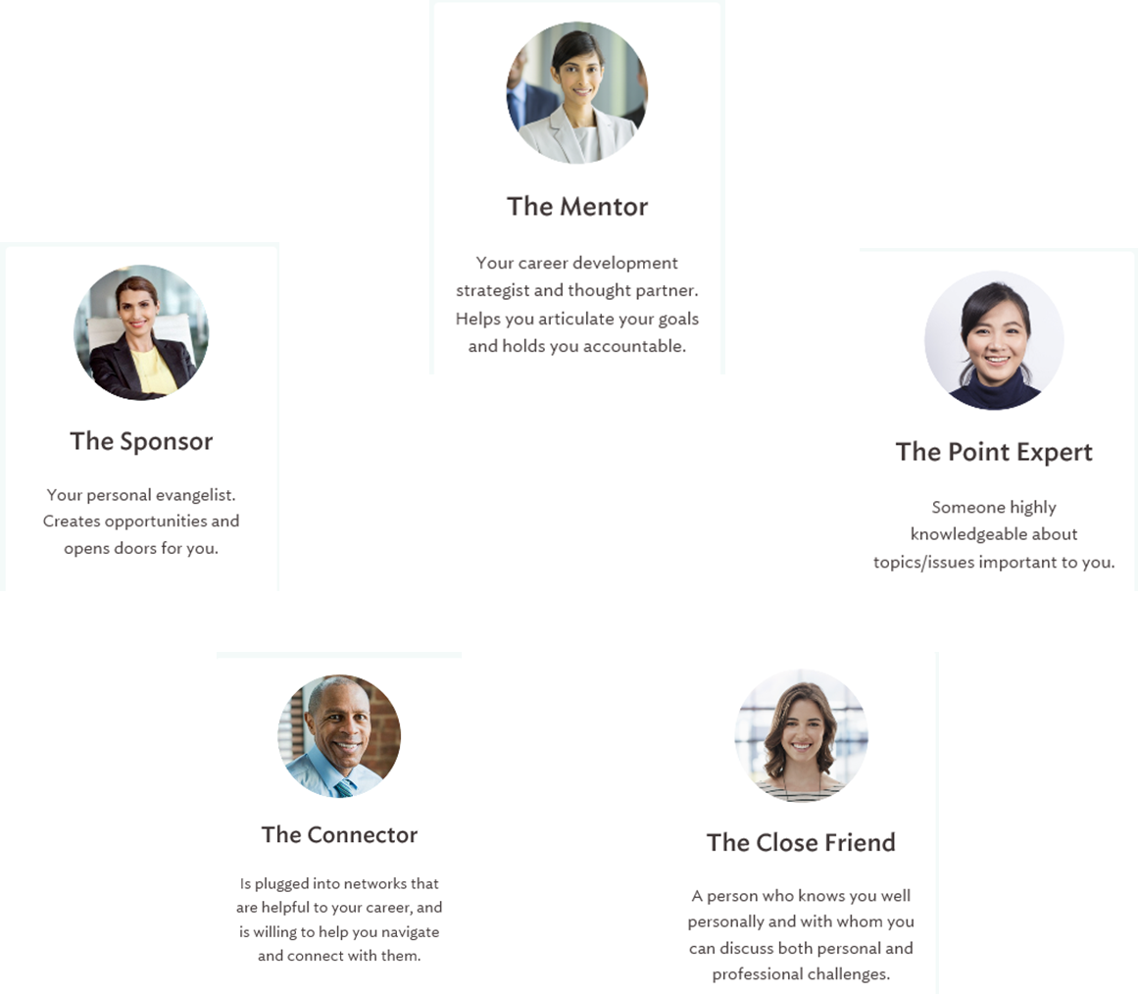
Your Personal Board of Advisors
Notes:
A personal board of advisors will be with you throughout your life and career. Multiple individuals may serve in the same capacity, and this board Will change over time, so constantly assess and adjust.
Mentors are those who will assist you in developing your career development strategy.
Point Experts are those in your highly knowledgeable in your subject areas of interest.
The Close Friend (SOROR!) – will tell you like it is. At all times!
The Connector – those who can make the important introductions
Sponsor – those that can make things happen for you.
Success is all about navigating relationships, and is as important, if not more important, than who you know.

Slide 10
Summary
Leverage this period of change to assess where you can change to improve your executive presence, and your overall professional position
Notes:
In summary, I like to quote Muhammad Ali – “Don’t count the days – make every day count”. Take advantage of this unexpected detour, and focus on the opportunities it may present to you in your professional career.

